Slide 1

E-COMMERCE 2.0
Pre se nte d by :
Subham Kumar (Roll No.: 10800219021) Supradip Das (Roll No.: 10800219027) Aryan Tiwari (Roll No.: 10800219059) Priyabrata Das (Roll No.: 10800219068)
Under Guidance of
Mr. Debabrata Maity

Slide 2
INDEX
CHAPTERS | SLIDES
Introduction | 03
Project Details | 04
Frontend | 05
Backend | 06
Project images and pictures | 07 – 11
Conclusion and scope | 12

Slide 3
Introduction
The E-Commerce 2.0 represents a better version of the already existing e-commerce sites. Since the time e-commerce have come into the picture, it has been of a huge help to us. It saves our time by letting us buy products that we want from the comfort zone of our own home.
It also makes it easy to order our desired products from any where just by a few clicks and also to deliver those products within a stipulated time to our own doorstep.

Slide 4
Project Details
S y s t e m R e q u i r e m e n t s :
SOFTWARE REQUIREMENTS :
Browser: Chrome, Firefox, Microsoft Edge.
HARDWARE REQUIREMENTS:
Processor: Any Processor
Speed: 1GHz to 2GHz
RAM: 256MB and above
Hard Disk: No Storage Required
Keyboard: Any Keyboard

Slide 5
FRONTEND
HTML: Hypertext Markup Language, a formatting system which helps us in displaying material retrieved over the Internet and as we all know, no webpage is complete without HTML in it, also it’s much easier to understand it.
CSS (Cascading Style Sheets) is used to style and layout web pages.
It is the language for describing the presentation of Web pages, including colors, layout, and fonts. It allows one to adapt the presentation to different types of devices, such as large screens, small screens, or even printers and the website that we are building might be used anywhere from a large screen monitor of a computer to a small screen personal smart phone.
Java script is used by programmers across the world to create dynamic and interactive web content like applications and browsers. JavaScript is so popular that it's the most used programming language in the world, used as a client-side programming language by 97.0% of all websites and that’s the reason we prefer Java script.

Slide 6
BACKEND
Django is a high-level Python web framework that enables rapid development of secure and maintainable websites and we all know every website needs proper maintenance so in that instant Django is a wise choice for our website according to us because as an e-commerce platform there might be a lot of load in our website as there might be a lot of clients and customers so an easily maintainable framework would be the best fit for a website as such.

Slide 7
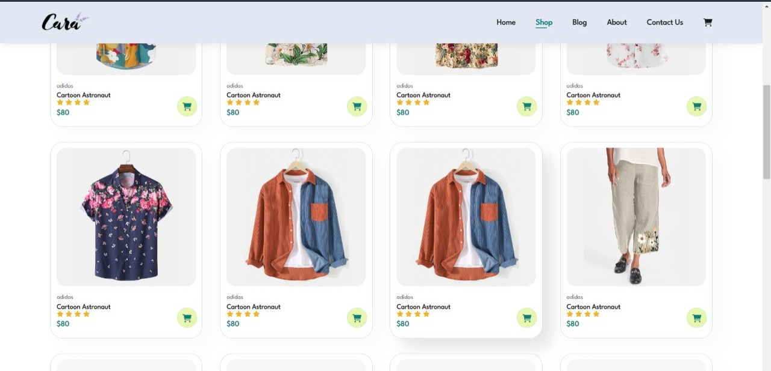

Slide 8
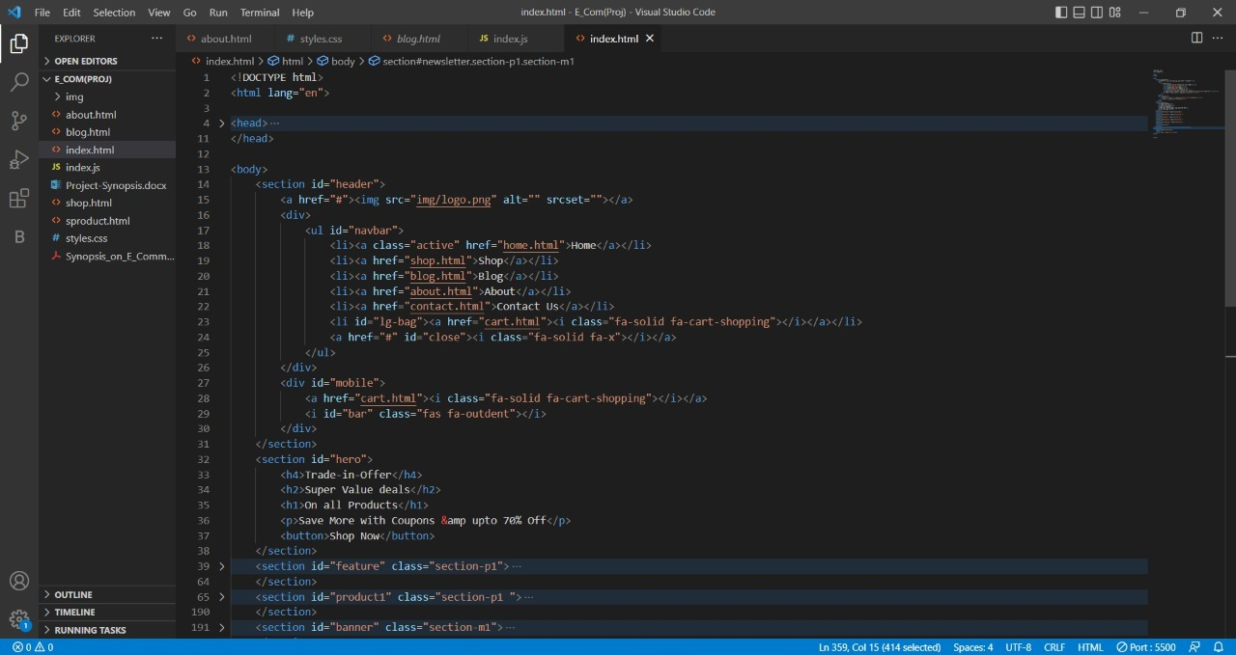

Slide 9
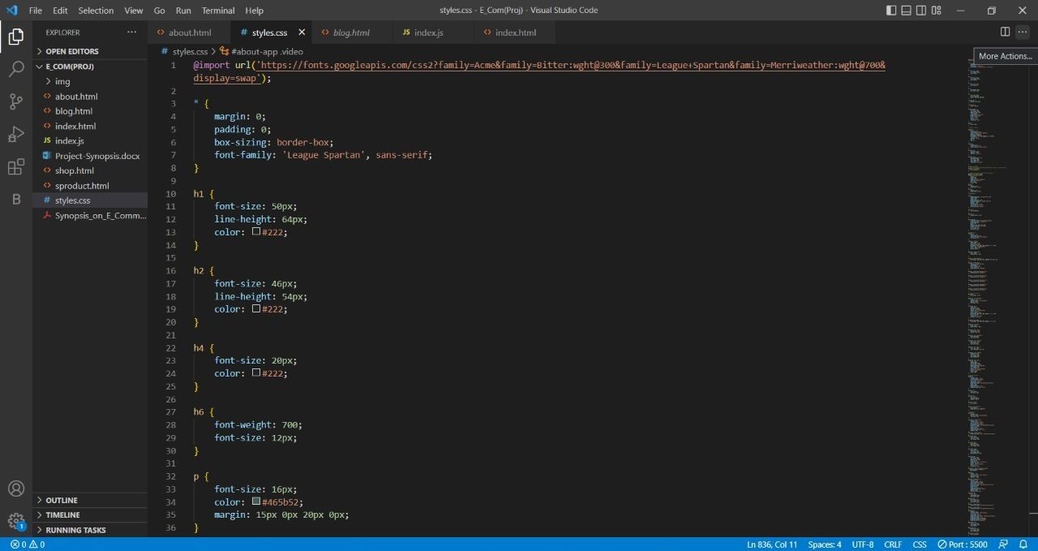

Slide 10
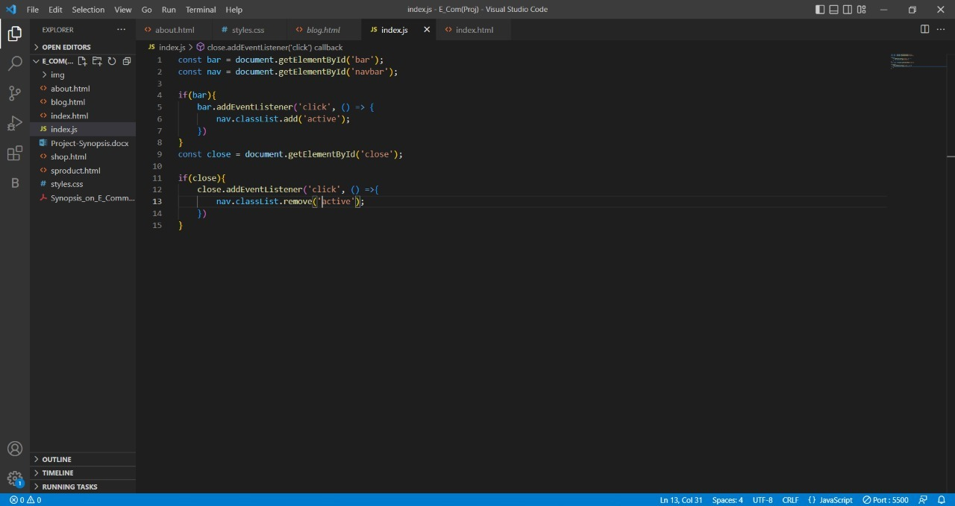

Slide 11
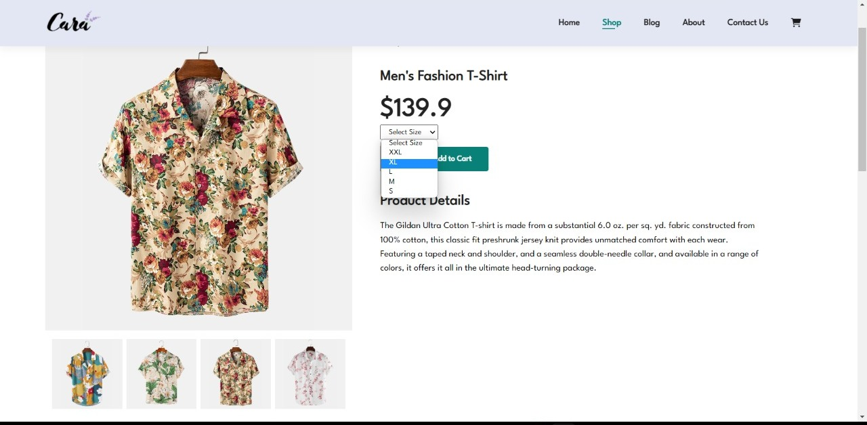

Slide 12
CONCLUSION AND SCOPE
Whatever the technology be there will always be room for improvements in any software package.
E-commerce is continuously progressing and is becoming more and more important to businesses, as technology continues to advance and is something that should be taken advantage of and implemented.
But the important thing is people should be flexible and understanding to accept further modifications and for that whatever the idea be it has to be user friendly as well as innovative. Right now we are just dealing with normal e-commerce software but with some advancements in ours E-commerce 2.0. But there are definitely scope for improvements too with proper technical guidance.
Our e-commerce platform provides smart delivery and transport along with smart address locator and future product price predictions on screen on the basis of past supply and demand graphs.
In future these can also be extended to:
Building up a community for customers.
Following an impactful Content Strategy.
Personalizing and delivering an Omnichannel Customer experience.

Slide 13
THANK YOU

